Slide 1

TITANIC DATASET ANALYSIS
EXPLORING PASSENGERs SURVIVAL AND DEATH
GROUP I
14TH NOVEMBER 2024

Slide 2
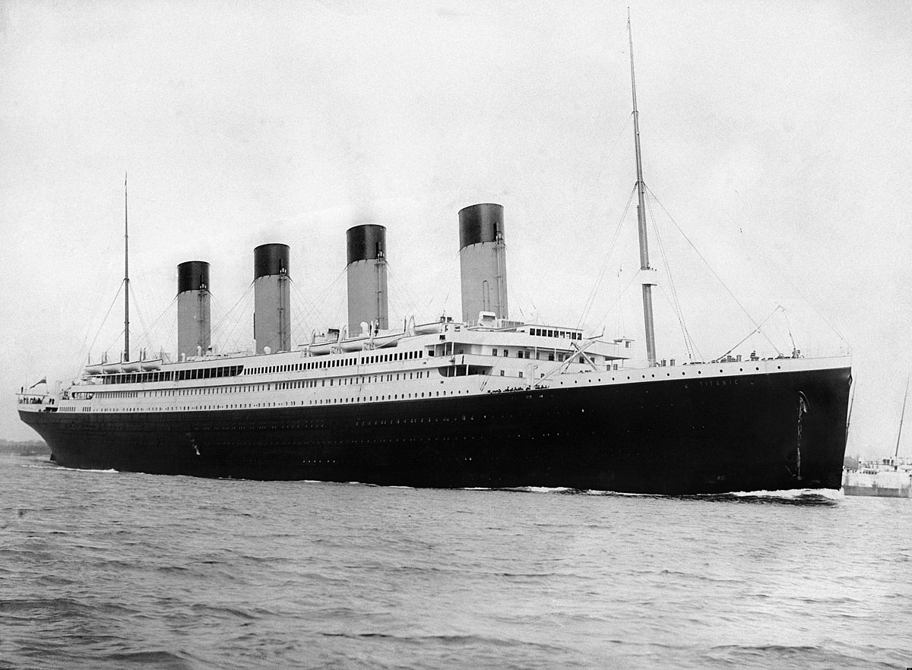
intrODUCTION
On April 15, 1912, the Titanic Ship sank, resulting in one of the deadliest maritime disasters in History.
The titanic dataset contains information on 891 passengers onboard the ill-fated ship.

Slide 3
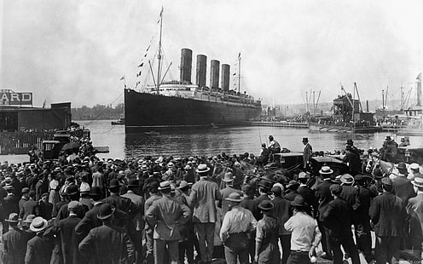
Introduction
The objective is to analyze the data to identify trends, patterns and correlations between passenger attributes and survival.
This report represents comprehensive analysis of the Titanic dataset focusing on passenger survival and death. Using Excel and Power BI, we visualized and gained insights from the data, exploring relationships between passenger information and survival rates.

Slide 4
Dataset overview
Variables: 12 (Passenger Id, Survived, Pclass, Name, Sex, Age, Sib/Sp, Parch, Ticket, fare, Cabin and Embarked)
Observations: 891

Slide 5
OBJEctiVES
Investigate the relationship between passenger attributes (gender, age, family size, embarkation port) and survival rates.
Examine the distribution of passenger ages, family sizes, and embarkation ports to understand passenger characteristics.
Analyze the distribution of ticket fares and compare average fares across passenger classes and embarkation ports.

Slide 6
methodology
The analysis was performed using the titanic dataset containing information on the passengers onboard the Titanic ship when it sank on April 15, 1912.
Data was processed and visualized with Excel and Power Bi.
The analysis includes the following key visualizations and insights:
Survival rate: What percentage of passengers survived?
Age Distribution: What is the average age oof passengers?
Sex Distribution: What is the proportion of male to female passengers
Class survival rate: Which passenger class had the highest survival rate?
Fare Distribution: What is the distribution of the fare paid by the passengers?

Slide 7
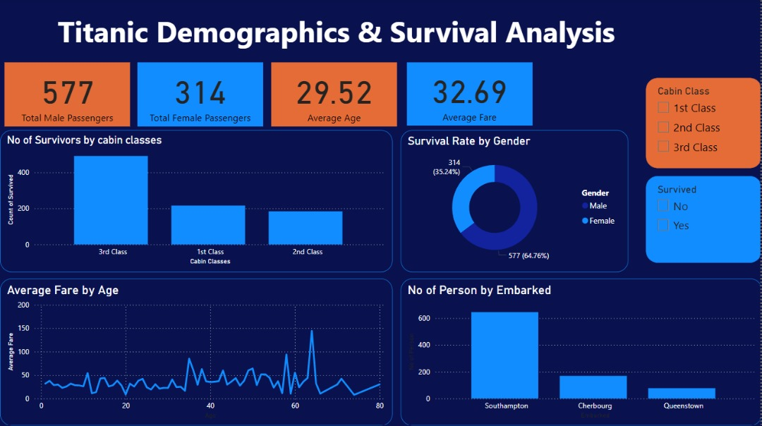
DATASET VISUALization

Slide 8
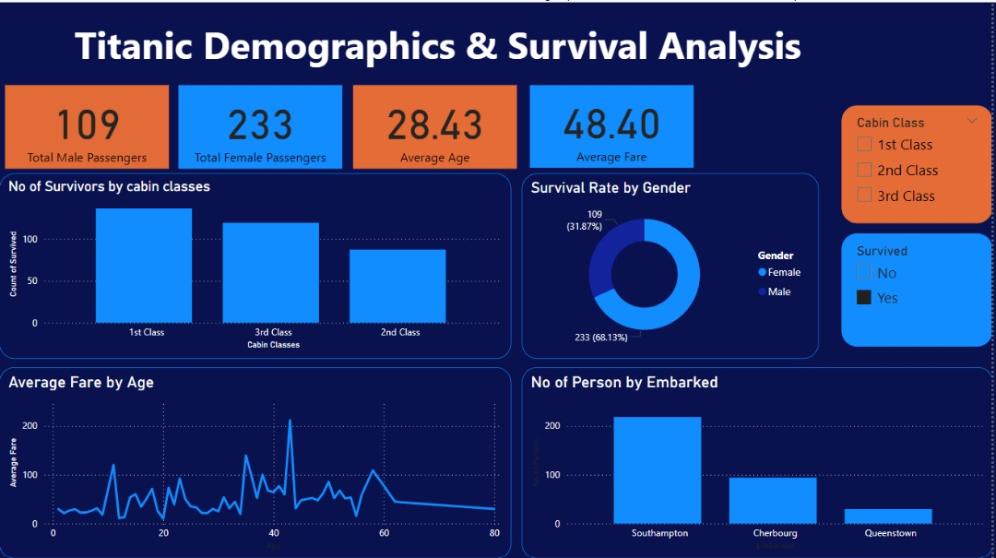
DATASET VISUALization - SURVIVed

Slide 9
Key findings
Survival disparity : Women , Children, and third -class passengers had significantly higher survival rates.
Class divided : First-class Passengers(60-70% survival rate) fared better than Third-class (20-30%).
Age and Sex : Younger Passengers and females had higher survival rates .
Fare distribution : Average fare ranged from $33 -$150, with significant variations across classes.

Slide 10
Conclusions
This comprehensive analysis of the titanic dataset has shed light on the pivotal factors influencing survival outcomes. The findings clearly demonstrate the profound impact of socio-economic and demographic characteristics on disaster outcomes. This study insight provides a foundation for developing protective models for disaster outcomes, informing evidence-based emergency response policies and exploring intervention to mitigate socio economic disparities.

Slide 11
RECOMMENDATIONS
Future research should investigate additional dataset to validate these findings, emergency response planners should integrate socio-economic and demographic considerations. Policymakers should also prioritize addressing preparedness in disaster and response to it.

Slide 12
THANK YOU

